Slide 1
COMP 1017
Photoshop Tutorial

Slide 2
Over the past several weeks, we’ve been using wireframes in our development process.

Slide 3
A wireframe is a visual mock-up for what our final website might look like.

Slide 4
So, how do we go about creating, editing, and measuring exact pixel lengths in a wireframe?

Slide 5
Photoshop
ﾟ*｡(･∀･)ﾟ*｡

Slide 6
The best way to figure out how to use Photoshop for web design purposes is to dive in and do it.

Slide 7
If you would like to take notes during the demo, download Photoshop Tutorial – Notes Guide from Day 20.

Slide 8
The following slides will be for reference purposes.

Slide 9
For now, let’s hop into Photoshop!

Slide 10
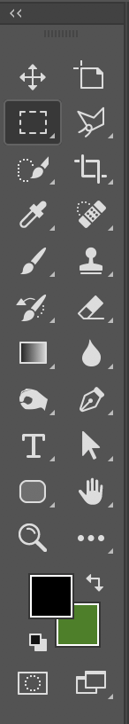
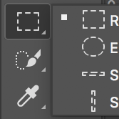
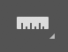
The basics tools you need
Selection Tool (V) - Allows you select different components of your Photoshop document and move them around.
Marquee Tool (M)
Allows you select rectangles, ellipses and 1-pixel rows and columns.
The marquee can be used to select different layers of your Photoshop document either using a fluid, fixed ratio, or a fixed sized.
Crop Tool (C) - Allows you to crop images, icons, etc either using a fluid, fixed ratio or a fixed size.
Zoom Tool (Z) - Zoom in and out of your document.
Keyboard Shortcuts: Zoom in: CTRL/CMD (+) Zoom Out: CTRL/CMD (-)
Eyedropper Tool (I) - Allows you to sample colours from an image.
Ruler Tool (I) - Allows you to measure the distance between elements.

Slide 11
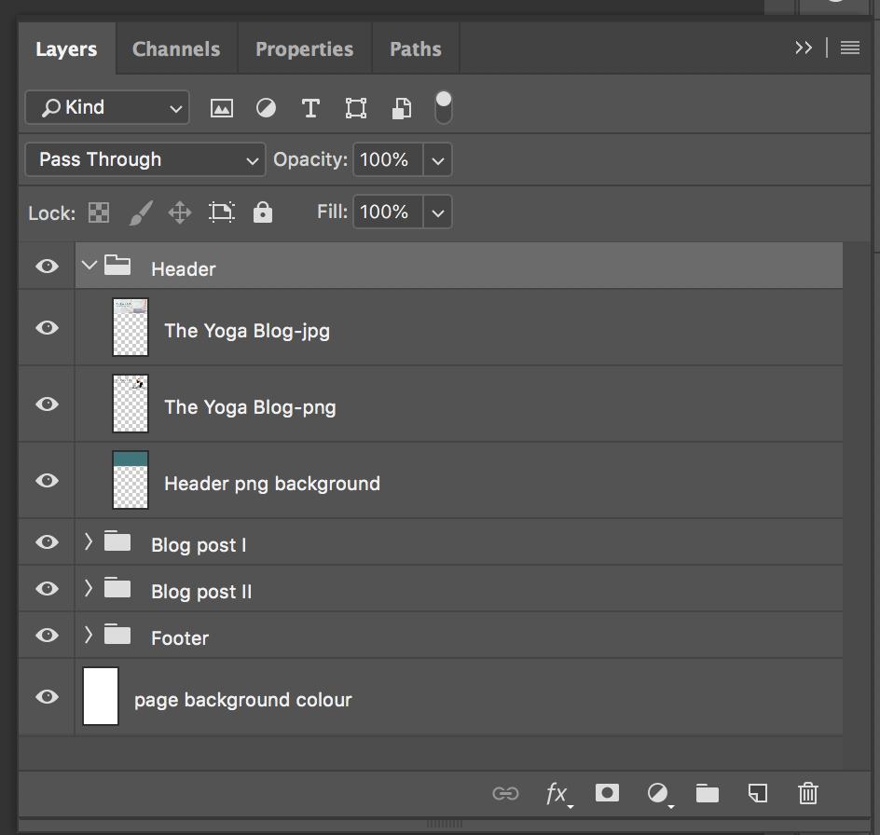
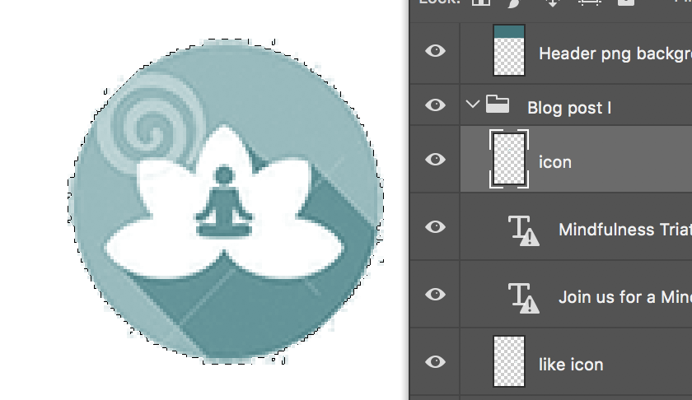
Layers Panel
Layers Panel
Image selection
Photoshop documents are created by using multiple layers. You can see the different layers by turning them on and off using the eye icon. Layers can be directly selected.
Keyboard Shortcut: CTRL/CMD + click (on the layer thumbnail)

Slide 12
Saving layers in new documents and new layers
Saving in a new document:
Select All components of the layer (CTRL/CMD + A) + Copy (CTRL/CMD + C)
Open a new PS document (CTRL/CMD + N)
Paste into new document (CTRL /CMD + V)
Any layer in your PS document can be saved in a new document or a new layer. This might make it easier when you are cropping and saving your images.
Saving in a new layer / duplicate layer:
Select All components of the layer (CTRL/CMD + A) + Copy (CTRL/CMD + C)
Create new layer (CTRL/CMD + SHIFT + N)
Paste into new Layer (CTRL /CMD + V)
Or you can just duplicate that layer (CTRL/CMD + J)

Slide 13
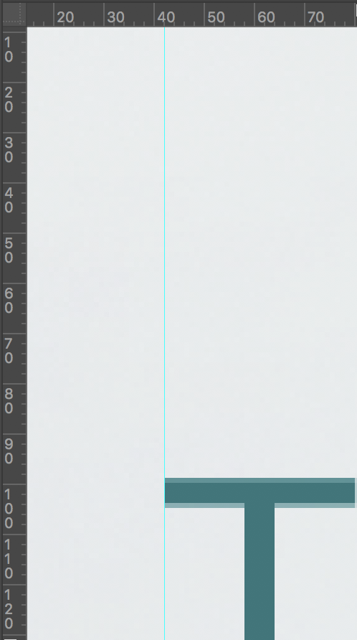
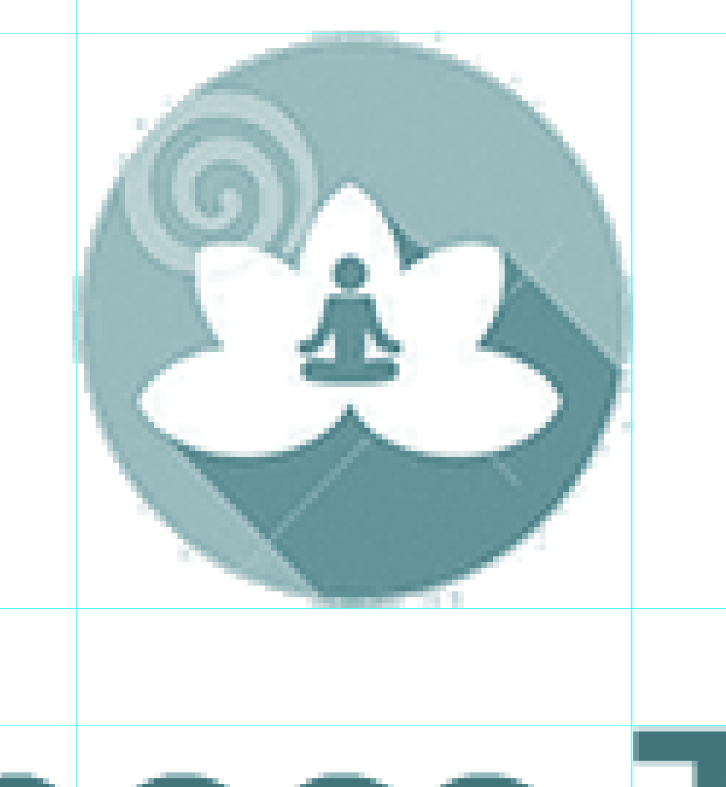
Rulers, Guidelines & Grids
Rulers
Guidelines
The rulers, guides and grids are extremely helpful to determine the spacing between elements.
Keyboard Shortcuts: >Show/hide rulers: CTRL/CMD + R >Show/hide guidelines: CTRL + ; (semi-colon) >Show/hide grid: CTRL/CMD + “ (quotes)

Slide 14
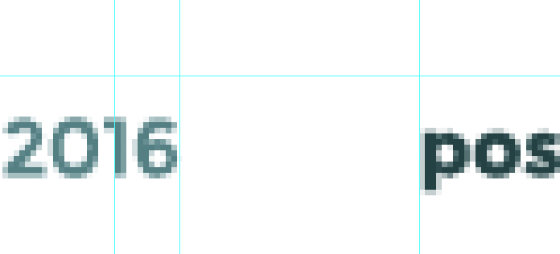
Using the rulers & guides to determine spacing
What is the spacing between the icon and the text?
Use your ruler tool and guides (an info palette should pop up - if not go to window > info).
Hint: Zoom in so you can see the pixels!
?
Answer: 40px total. Which mean each element has a margin left and right of 20px!

Slide 15
Cropping and saving images for web
Open up your Photoshop document (psd) make sure you have your selection tool (v) selected. Hide your background layer.
Select an image/icon to crop. Let’s crop out the one of the larger icons. We are going to use our marquee tools and set a fixed width of 100px by 100px. ( you can find out the size of image by directly selecting the image (you should see marching ants), and clicking on your info palette. You’ll see the size of the icon is 96px by 99px).
After you happy with the placement of your fixed selection. Select the crop tool ( C ). Click on your selection and hit enter on your keyboard (or double click).
Go to File > Export > Save for web.
What format should this be in? Gif, png-8, png-24, jpg? We will be saving this as the smallest file size for the icon which is a gif.
See next slides for image examples.
Using Photoshop we are going to be cropping out our images and then saving (exporting) them for our web.
We are going to do this by using our selection and crop tools, this can be accomplished by using fixed sizing or normal (not fixed).

Slide 16
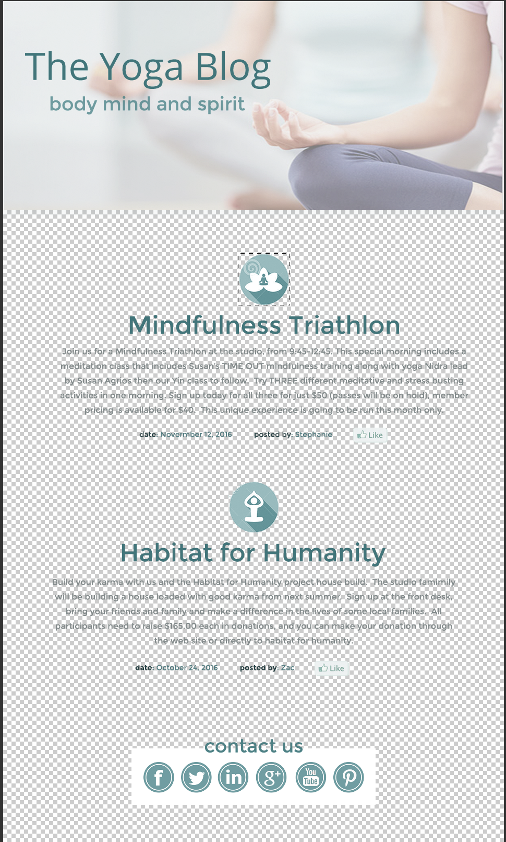


Step 1: Open psd and hide background colour layer
Step 2: Select the Marquee Tool (M) and set a fixed size of 100px by 100px. Click on the artboard/canvas and place your selection around your icon/image
This dotted line looks like “marching ants”

Slide 17
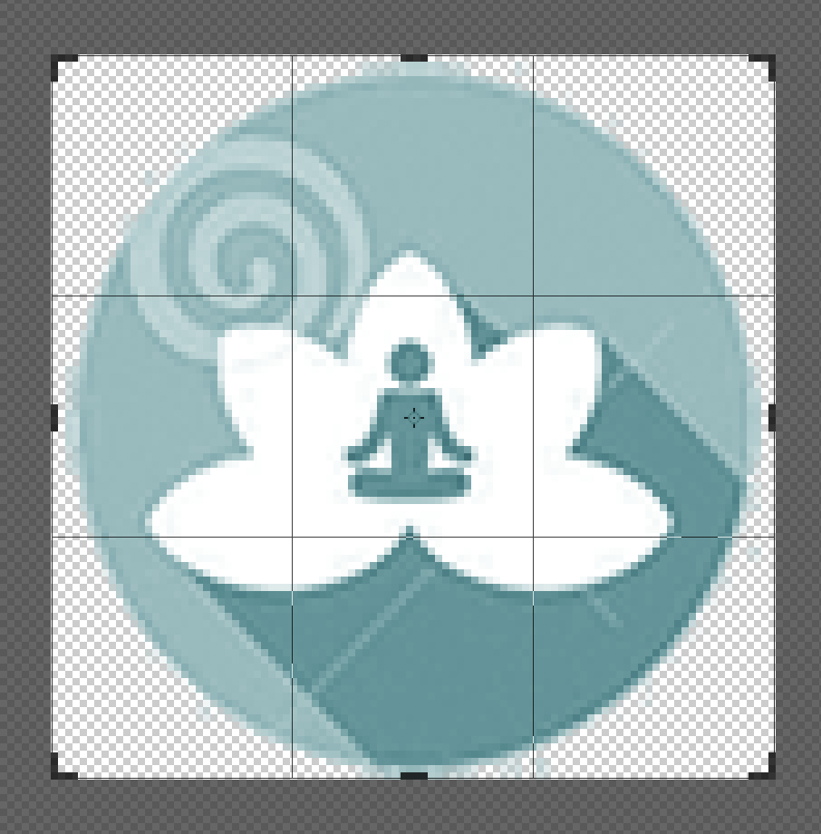
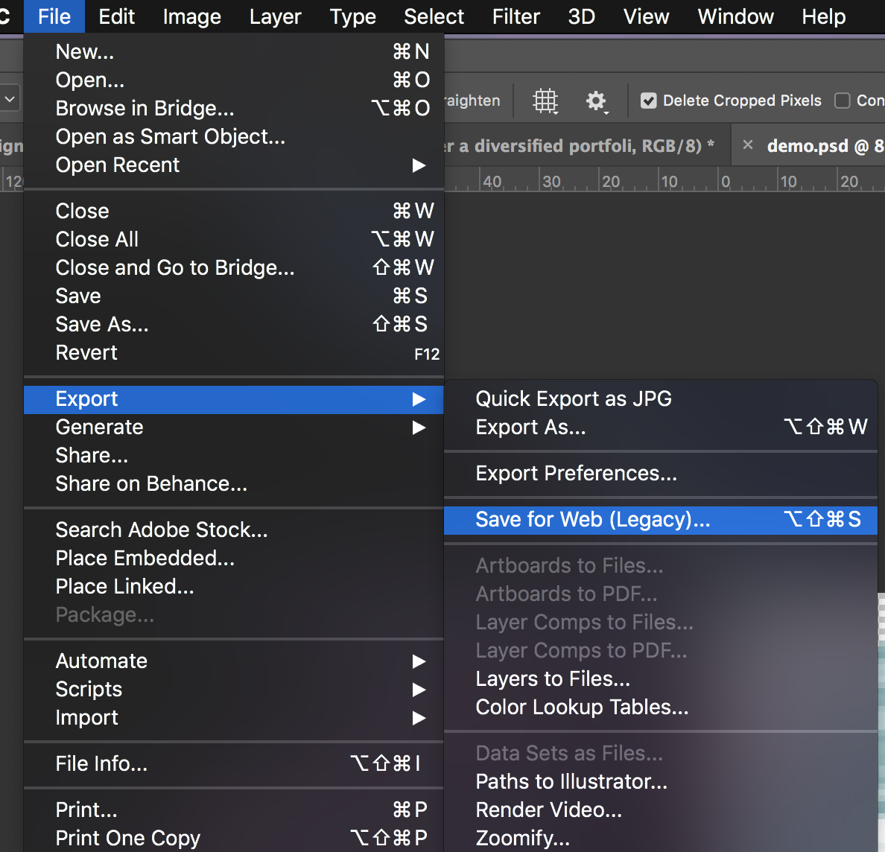

Step 3: Select the Crop Tool ( C ) and crop your image.
Step 4: Go to File > Export > Save For Web
Cropping
Completed Crop

Slide 18
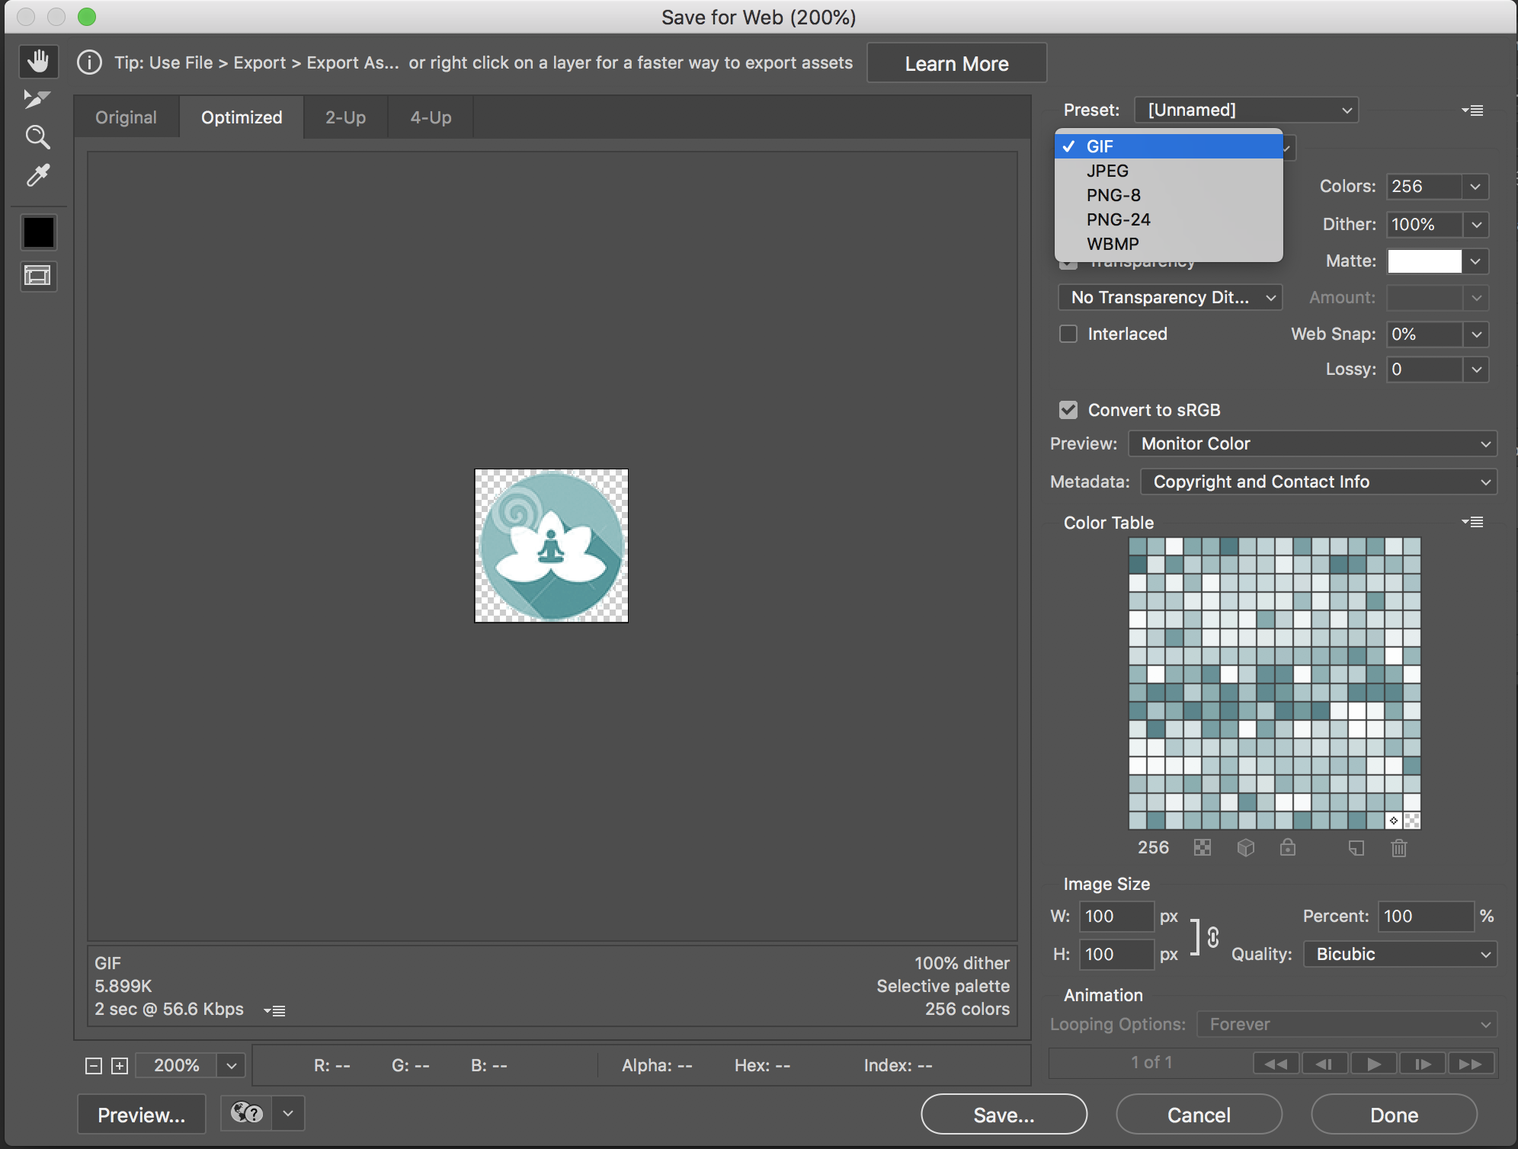
Step 5: Save your image as gif file format and click save.

Slide 19

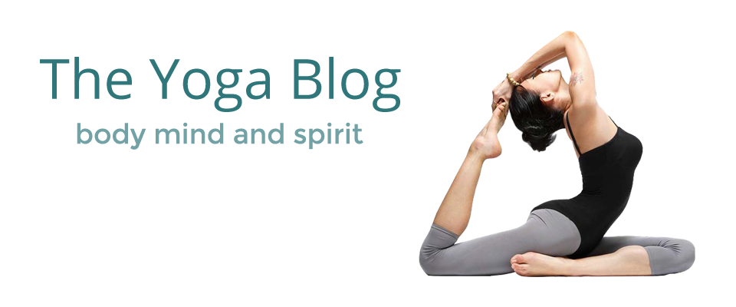



File Formats and optimizing for web.
We can save images as multiple different file formats, but what is best file formats the web? When working with imagery for the web, we want to make sure making sure our images are small and optimized so our websites load quickly.

Slide 20
File Formats and optimizing for web.
GIF: Are used for saving vector art images/icons. When gifs are saved they use lossless compression which keeps the quality of the image and can store up to 256 colours.
JPEG: One of the most common file formats for saving web images. Use lossy compression which reduces the file size with little loss in image quality.
PNG: Supports background transparency from opaque to completely transparent.
PNG24: Uses 24-bit colour, and preserves the quality of image when saved use lossless compression. PNG images tend to be a larger file format than jpgs.
PNG-8: Uses 8-bit colour and functions a lot like the gif file format, however the png-8 can compress images 10% - 30% smaller than a gif. Not supported by all browsers.
Notes:
https://helpx.adobe.com/photoshop-elements/using/optimizing-images-gif-or-png.html
https://helpx.adobe.com/photoshop-elements/using/optimizing-images-png-24-format.html

Slide 21
Keyboard Shortcuts
Selection Tool (V)
Crop Tool (C)
Zoom Tool (Z)
PC: zoom in/out: CTRL +/-
Mac: zoom in/out: CMD +/-
Marquee Tool (M)
Eyedropper Tool (I)
Ruler Tool (I)
Rulers:
PC: Show/hide rulers: CTRL + R
Mac: Show/hide rulers: CMD + R
Guides/Guidelines
PC: Show/hide guidelines: CTRL + ; (semi-colon)
Mac: Show/hide guidelines: CMD + ; (semi-colon)
Grid
PC: Show/hide grid: CTRL + “ (quotes)
Mac: Show/hide grid: CMD + “ (quotes)
Save For Web
PC: CTRL + ALT + SHIFT + S
Mac: CMD +OPTION + SHIFT + S

Slide 22
Keyboard Shortcuts
Select All (in a layer)
PC: CTRL + A
Mac: CMD + A
New Document
PC: CTRL + N
Mac: CMD + N
New Layer
PC: CTRL + SHIFT + N
Mac: CMD + SHIFT +N

Slide 23
Supplementary Reading
GIF & PNG-8 Format
https://helpx.adobe.com/photoshop-elements/using/optimizing-images-gif-or-png.html
PNG-24 Format
https://helpx.adobe.com/photoshop-elements/using/optimizing-images-png-24-format.html

Slide 24
Valerie Watson
she / her
vwatson@nait.ca

